Slide 1
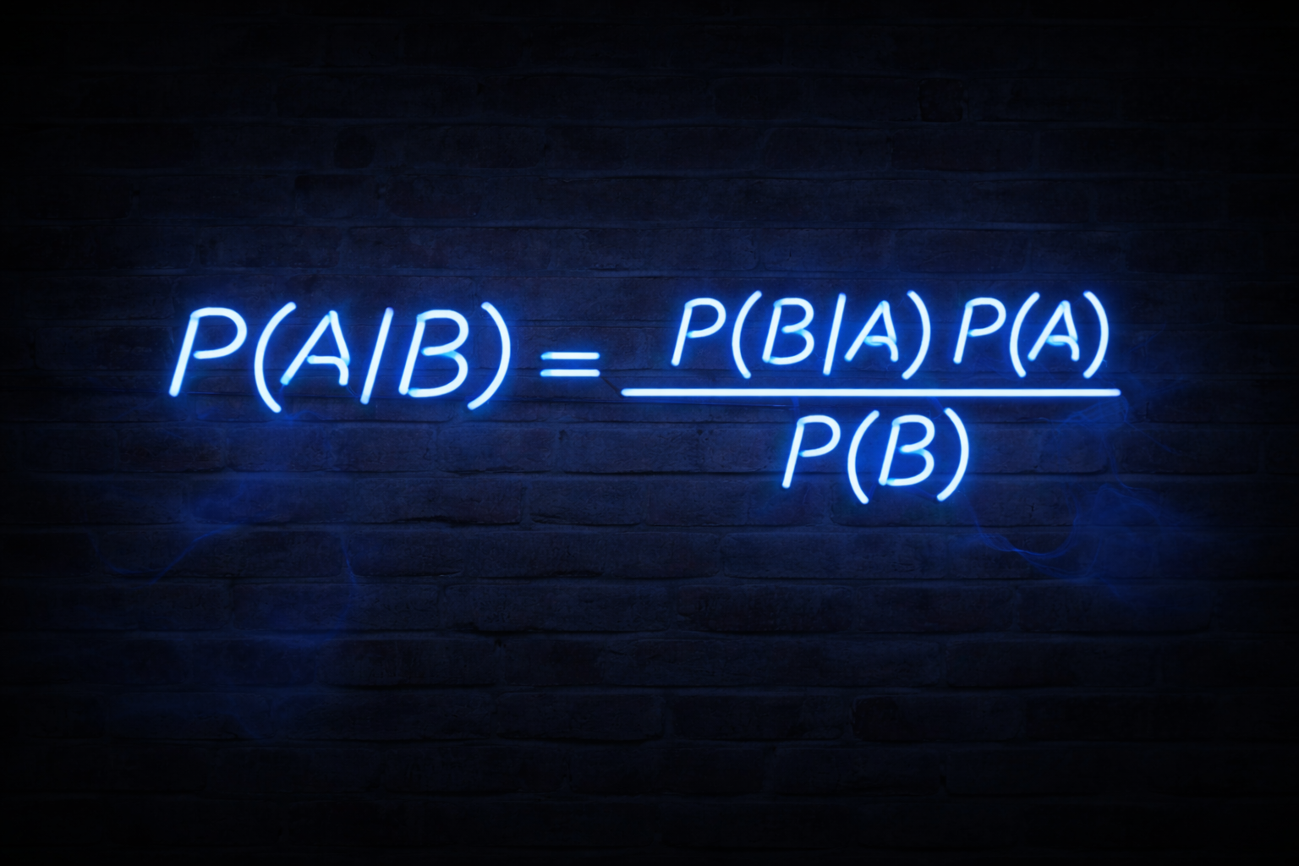

Slide 2
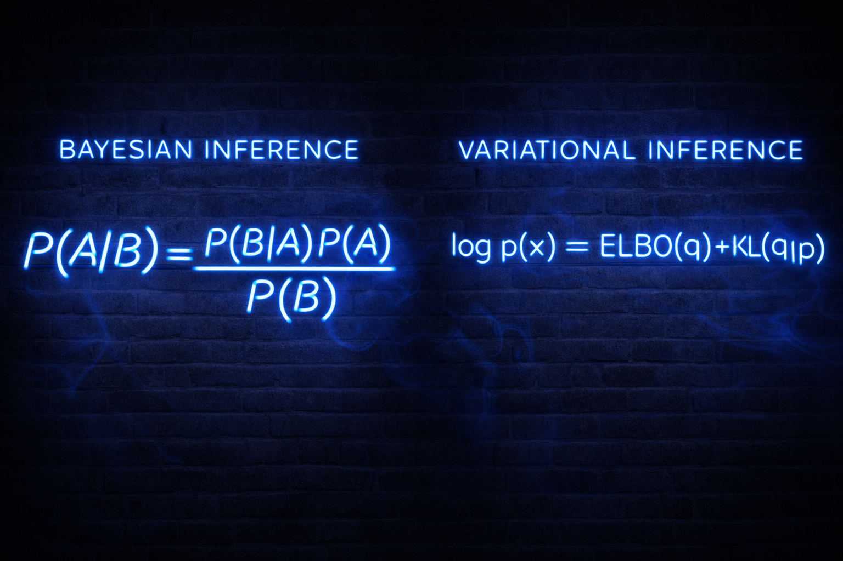

Slide 3
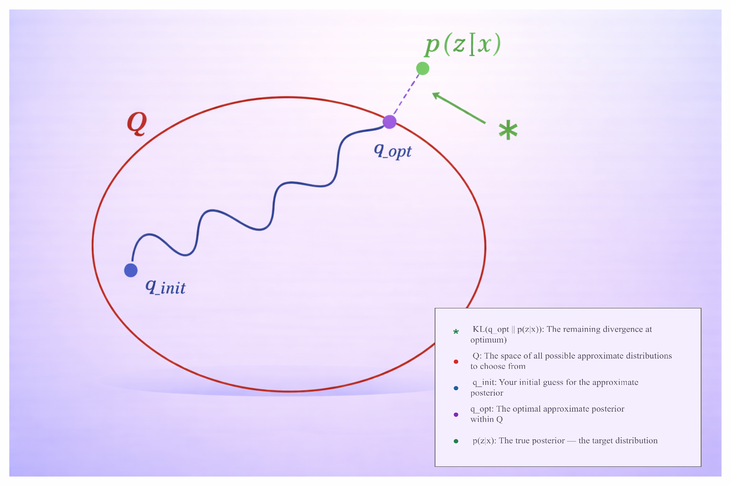

Slide 4
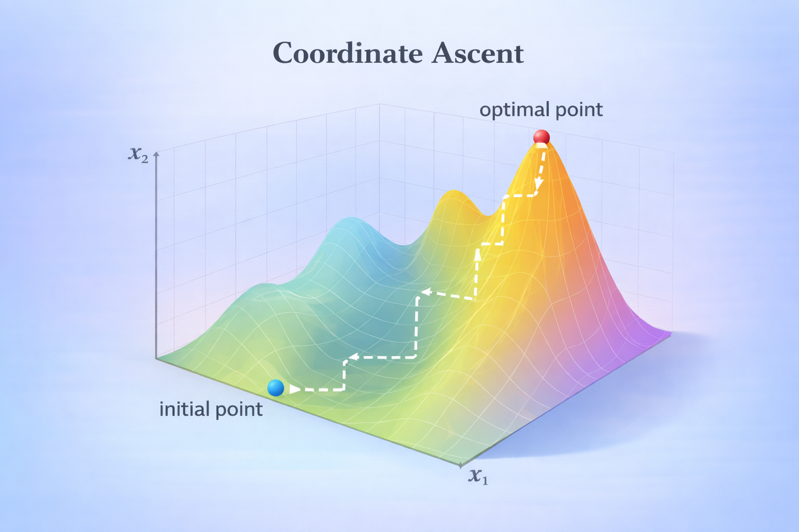

Slide 5
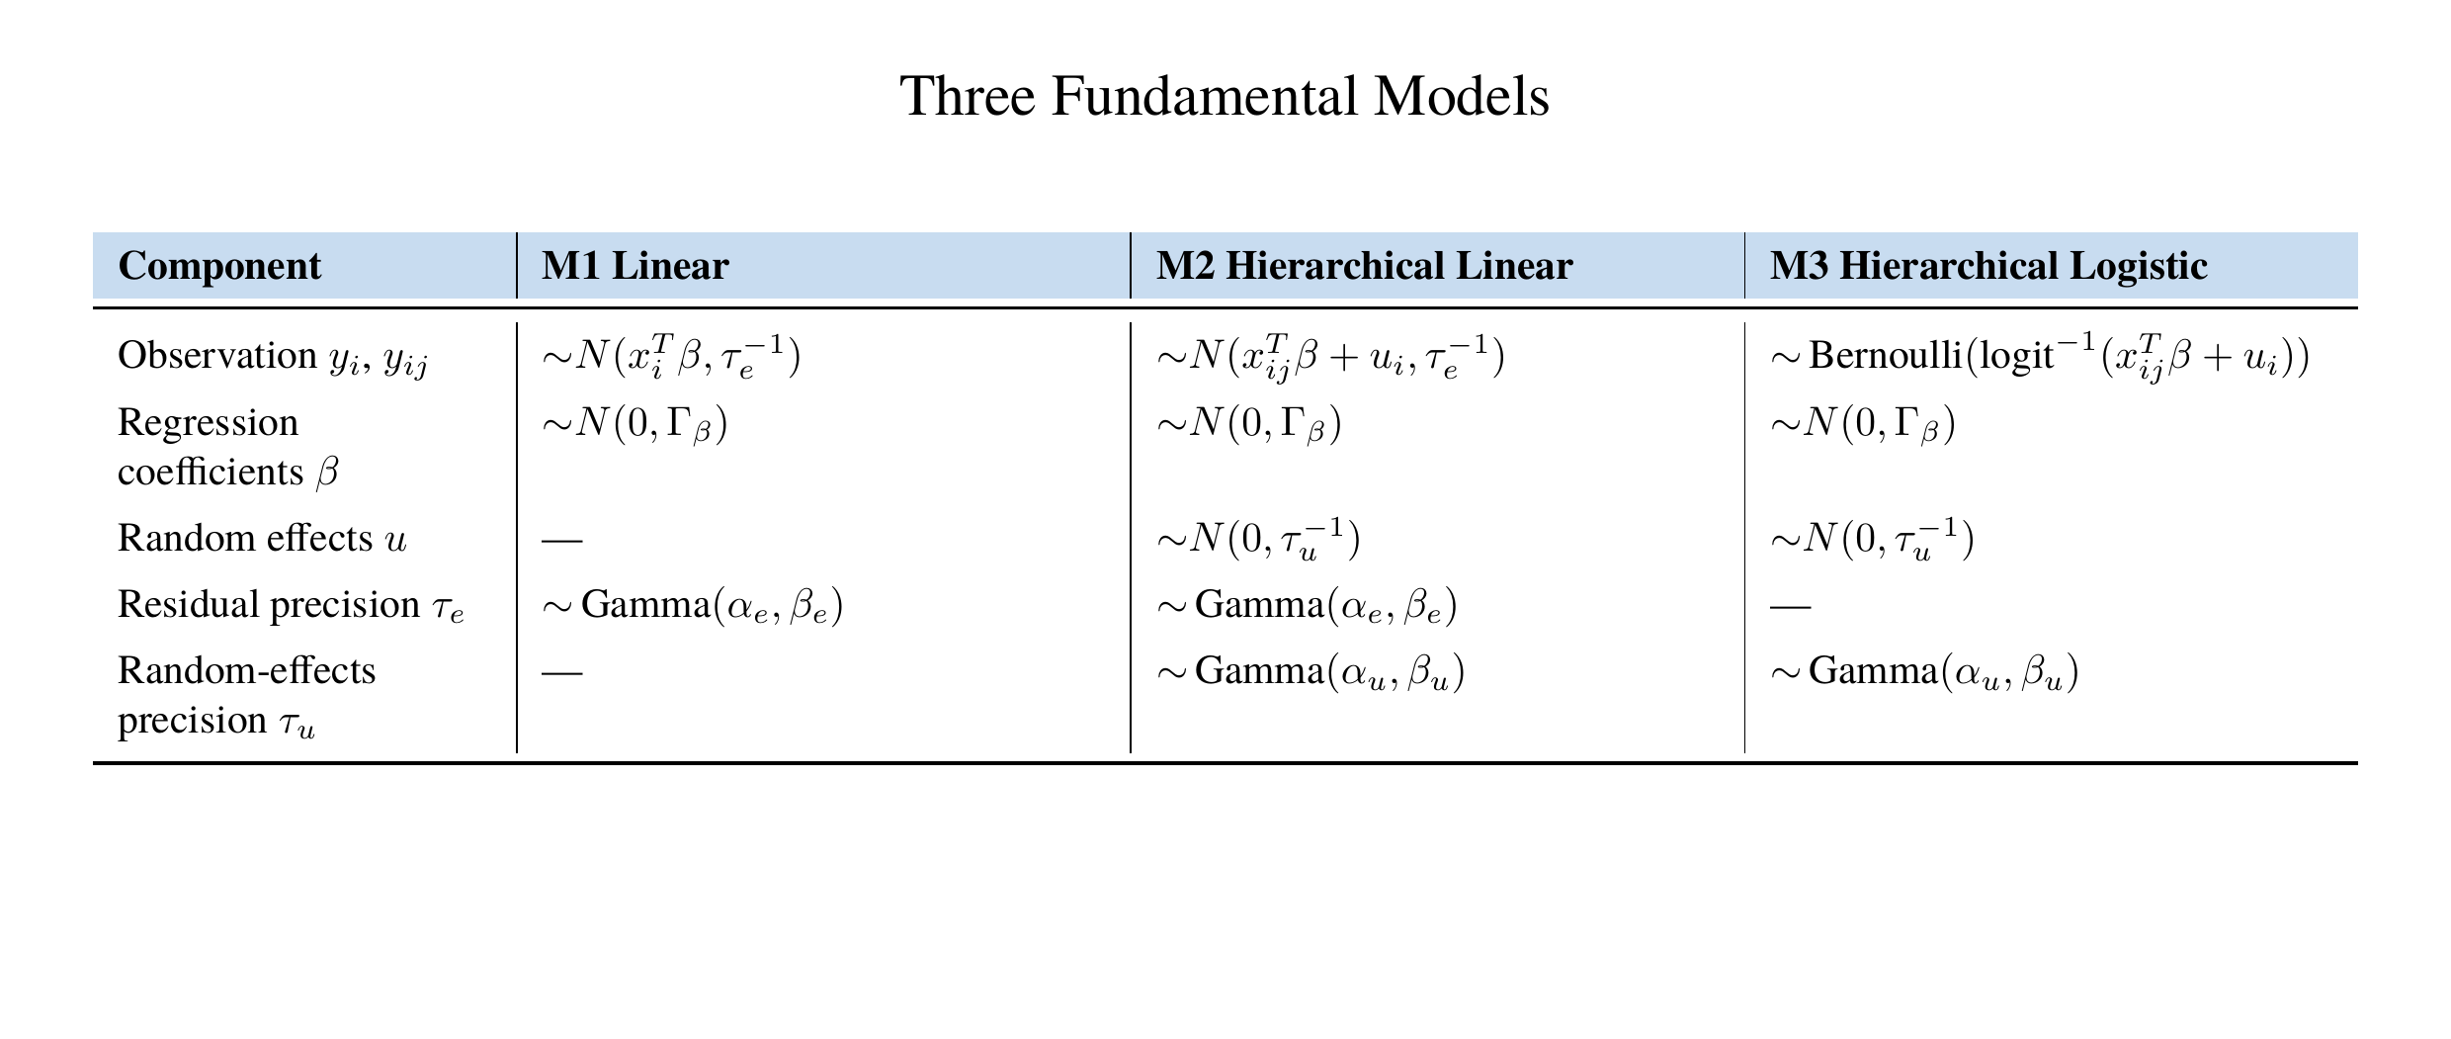

Slide 6
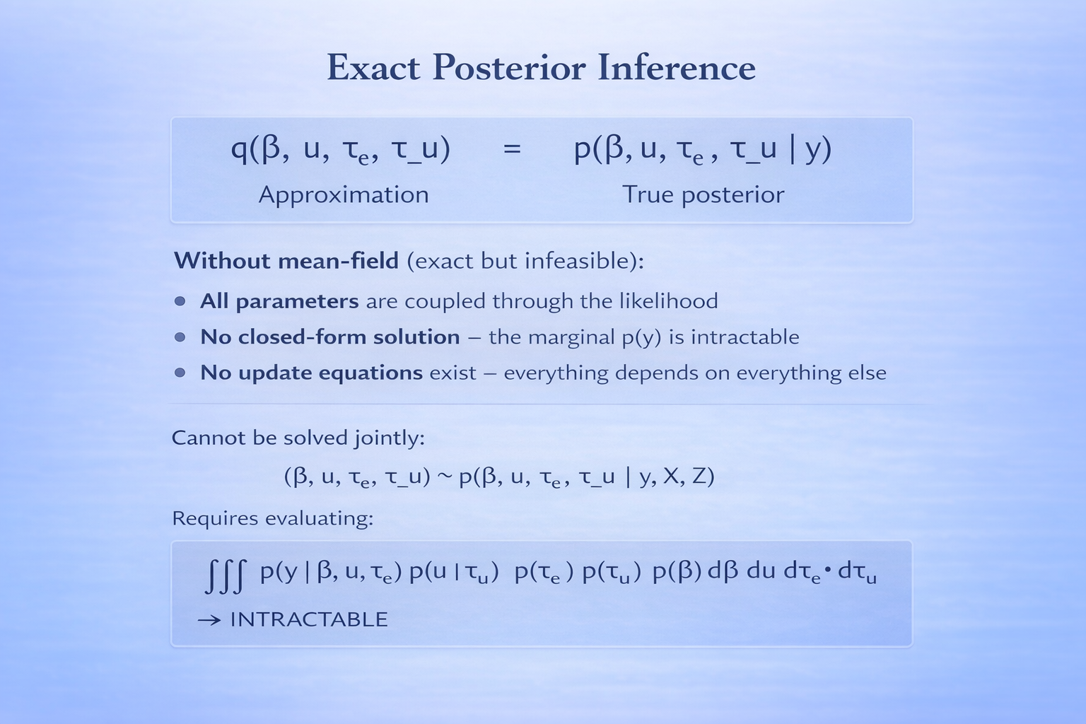

Slide 7
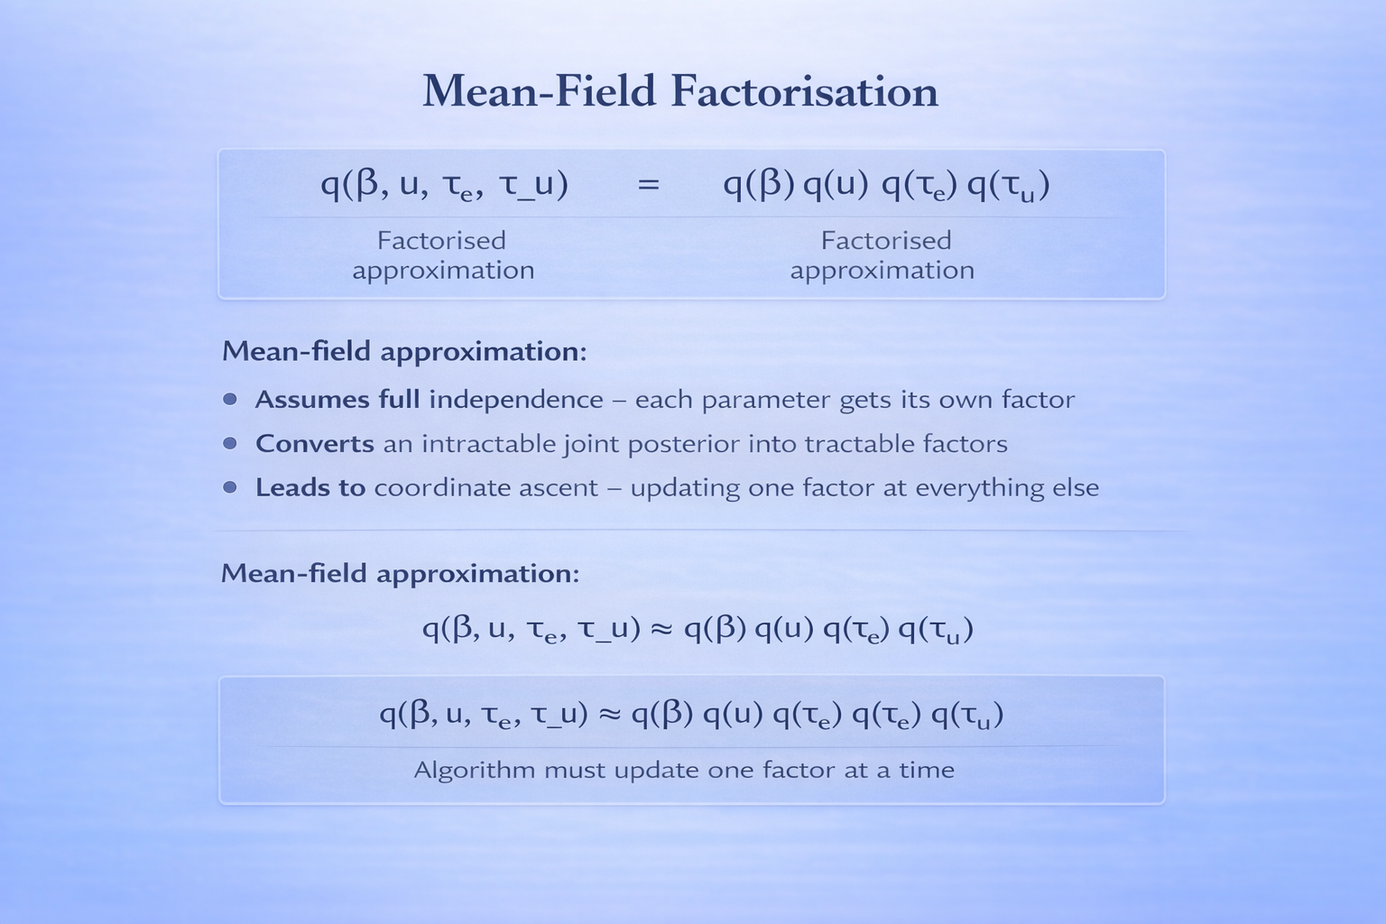

Slide 8
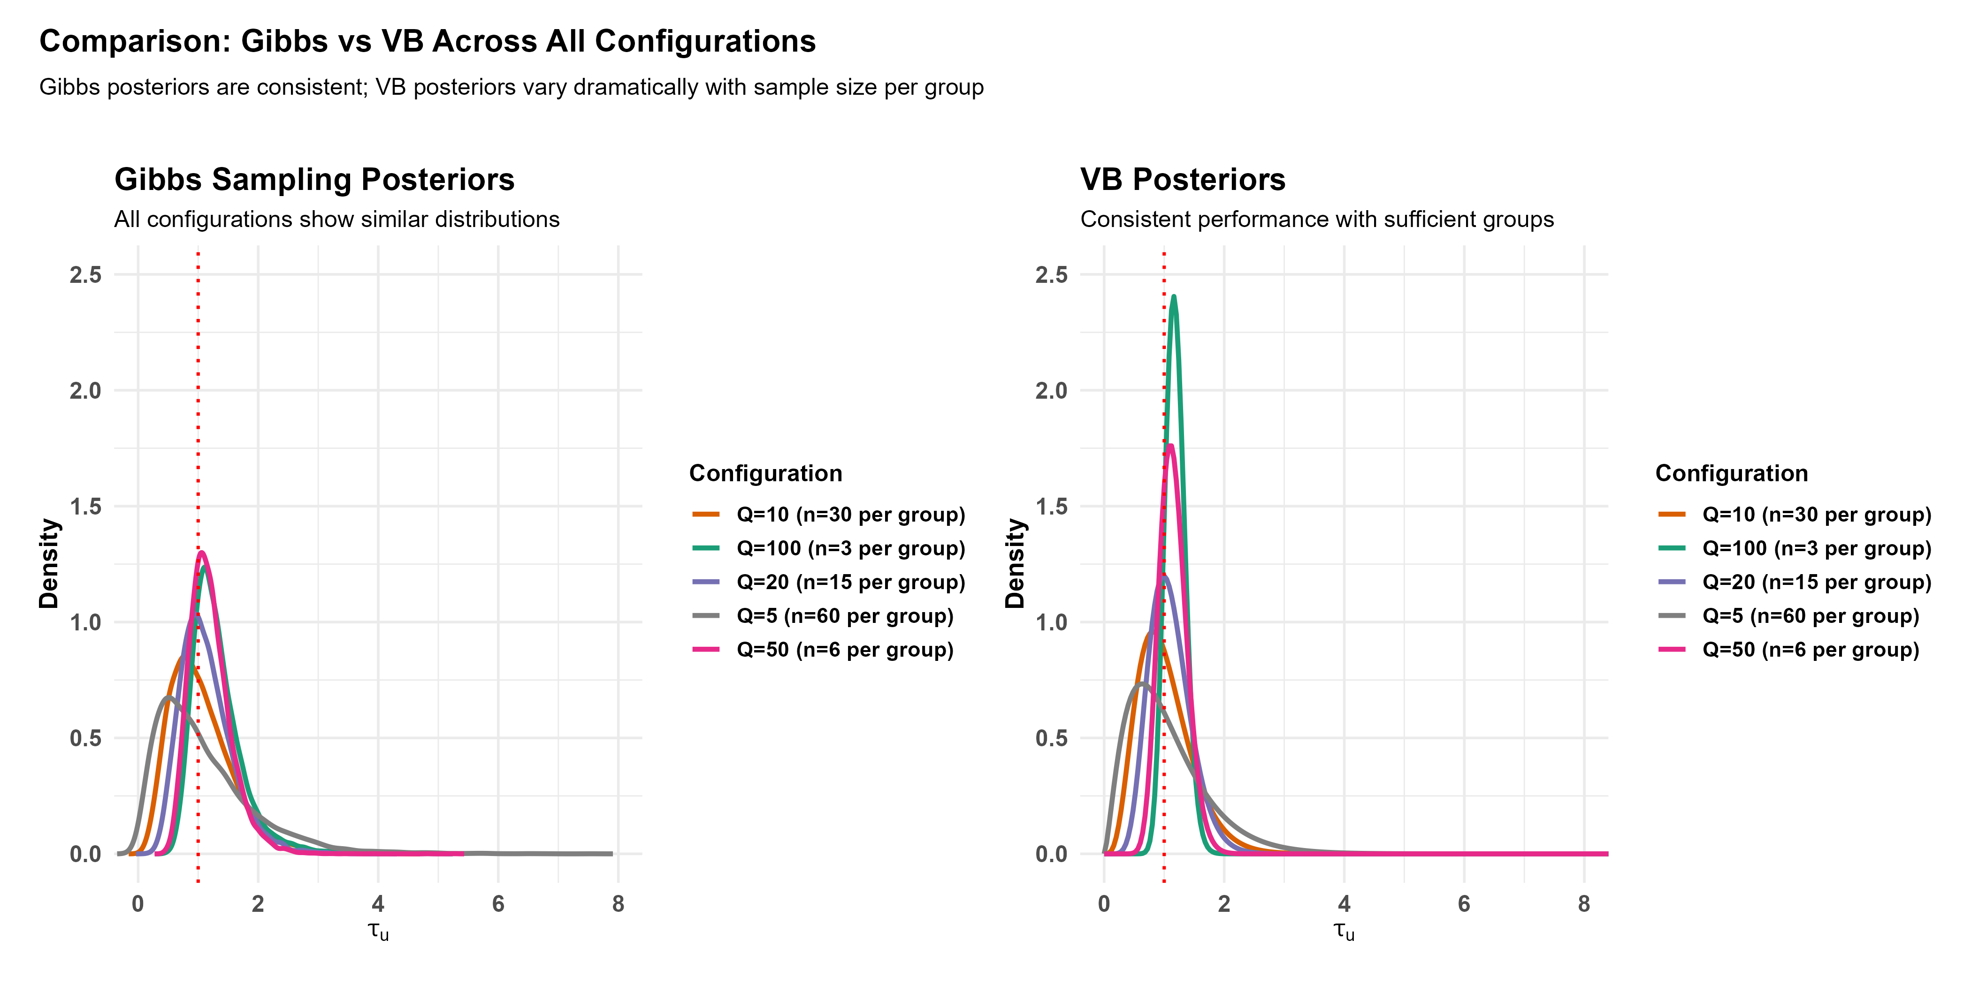

Slide 9
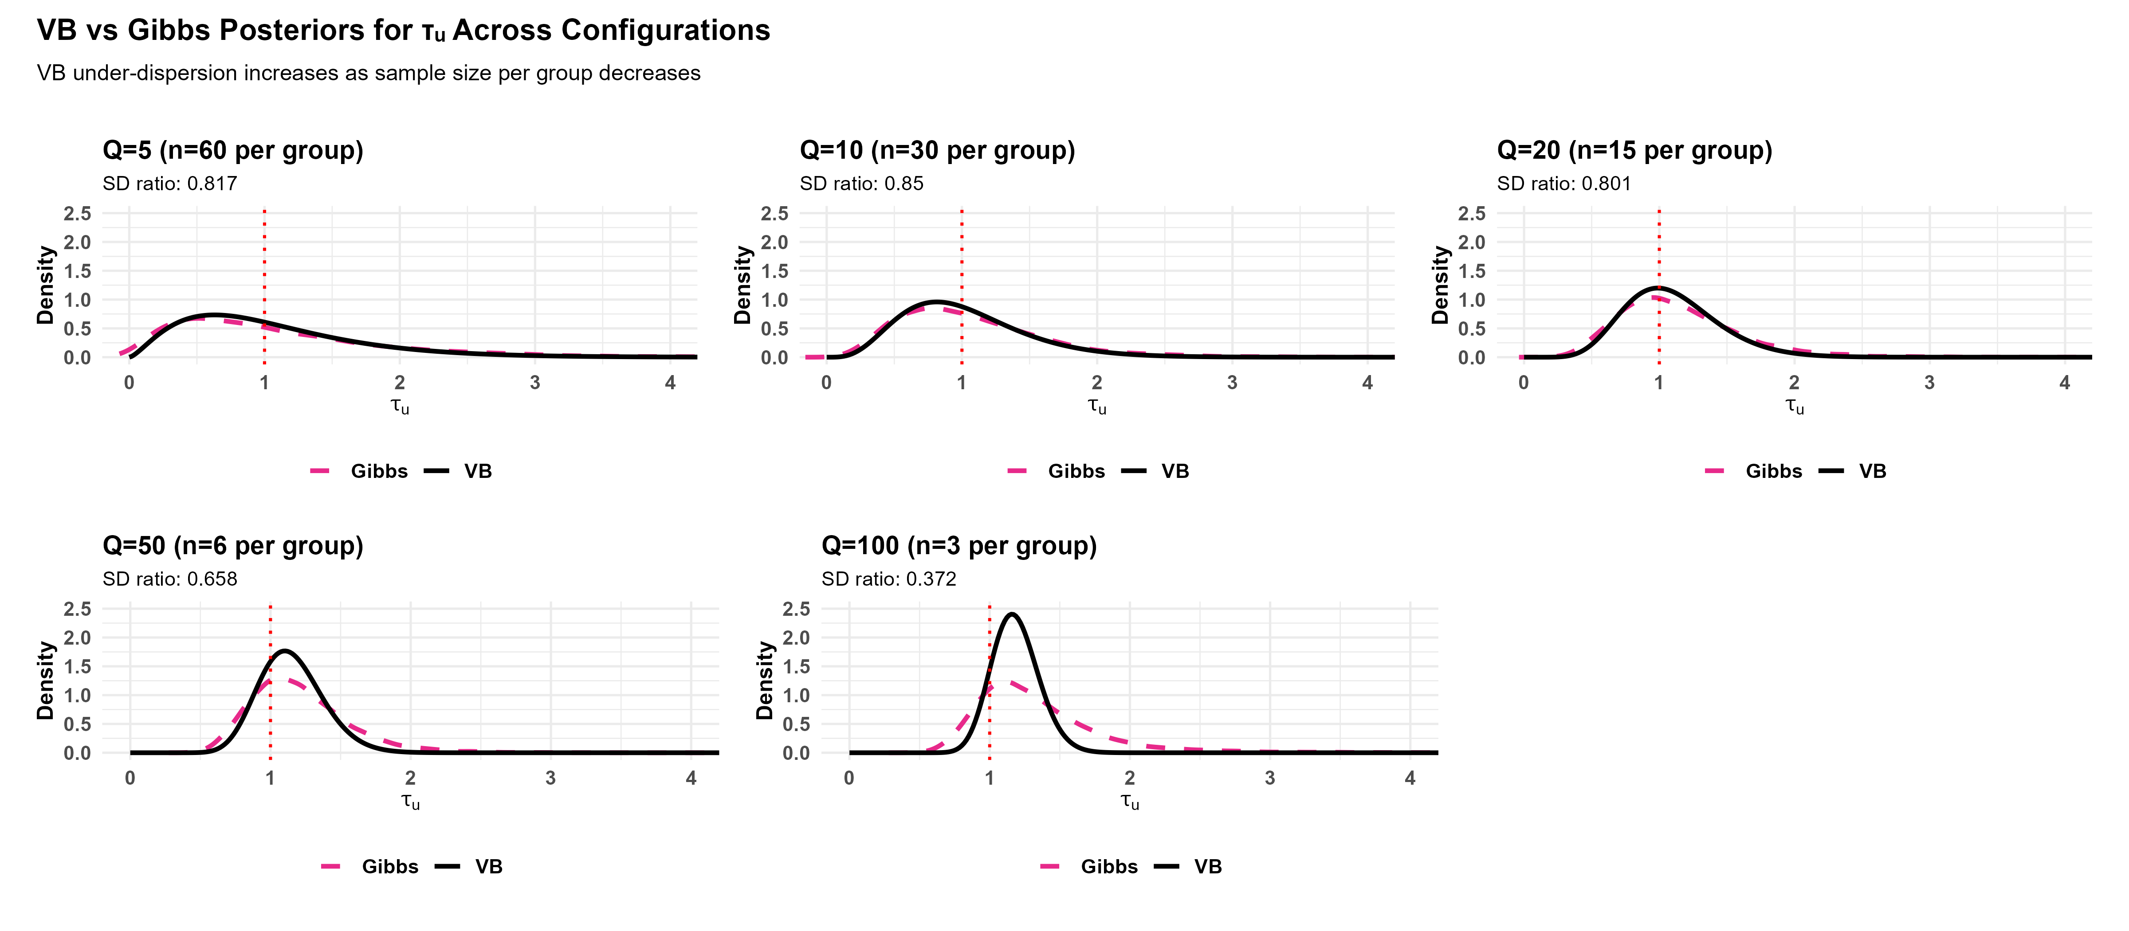

Slide 10
Model | Q | β₀ | β₁ | β₂ | τₑ | τᵤ | σ²ₑ | σ²ᵤ | What it means / Practical consequence | When it matters
M1 | — | 1.000 | 0.993 | 0.988 | 0.994 | NA | NA | NA | All β near 1.0 = excellent: Fixed effects highly reliable for predictions | Trust for all inference
M2_Q5 | 5 | 0.721 | 0.994 | 1.014 | 0.995 | 0.817 | NA | NA | β₀=0.721 (28% too narrow), τᵤ=0.817 (18% too narrow): Intercept unreliable; severely underestimates group differences | Do not trust for between-group questions
M2_Q10 | 10 | 0.889 | 0.998 | 0.994 | 0.970 | 0.850 | NA | NA | β₀=0.889 (11% too narrow), τᵤ=0.850 (15% too narrow): Moderate under-dispersion in intercept and group variation | Use caution for variance component inference
M2_Q20 | 20 | 0.961 | 0.993 | 0.988 | 0.962 | 0.801 | NA | NA | τᵤ=0.801 (20% too narrow): Group variation underestimated | Important concern for hierarchical inference
M2_Q50 | 50 | 0.992 | 0.998 | 0.985 | 0.913 | 0.658 | NA | NA | τᵤ=0.658 (34% too narrow): Serious under-dispersion in group variance | Major problem for between-group uncertainty
M2_Q100 | 100 | 0.994 | 1.000 | 0.986 | 0.803 | 0.372 | NA | NA | τᵤ=0.372 (63% too narrow): Catastrophic under-dispersion | Never use VI for this parameter - use HMC

Slide 11
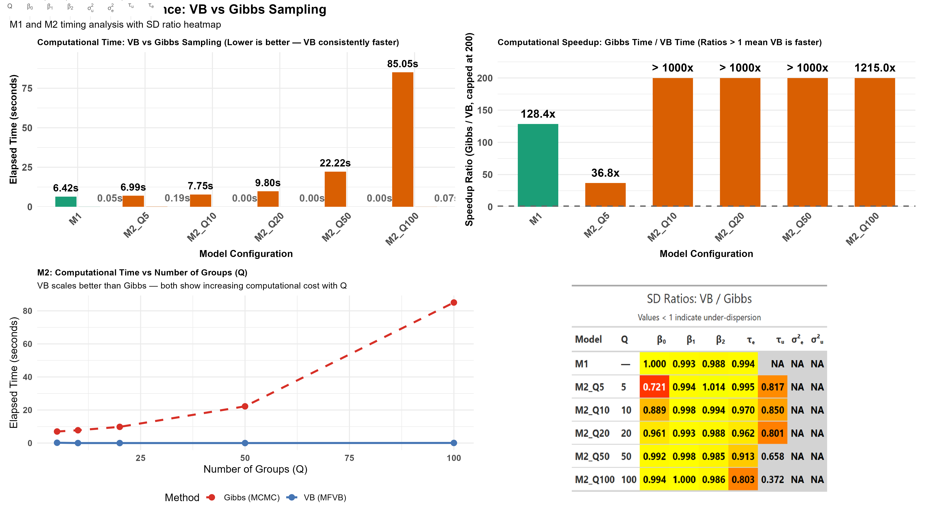

Slide 12
Conclusion: Variational Bayes Trade-offs
Key Findings:
• VB achieves 100–1200× speedup over Gibbs sampling
• Fixed effects (β) estimates: Excellent accuracy
• Variance components (τᵤ, σ²ᵤ): Systematic under-dispersion
• Under-dispersion worsens with fewer observations per group
Practical Guidance:
• Use VB for: Fixed effects, large-scale problems, initial exploration
• Use Gibbs/HMC for: Variance components, hierarchical uncertainty, final inference
Active Research:
• Structured variational approximations (Blei et al., 2017)
• Expectation propagation methods
• Hybrid VB-MCMC approaches
• Adaptive variational families
The under-dispersion issue is well-documented and remains an active area of research.

Slide 13
References
Blei, D. M., Kucukelbir, A., & McAuliffe, J. D. (2017). Variational Inference: A Review for Statisticians. Journal of the American Statistical Association, 112(518), 859-877
Jordan, M. I., Ghahramani, Z., Jaakkola, T. S., & Saul, L. K. (1999). An Introduction to Variational Methods for Graphical Models. Machine Learning, 37(2), 183-233
Turner, R. E., & Sahani, M. (2011). Two Problems with Variational Expectation Maximisation for Time-Series Models. Bayesian Time Series Models, 109-130
Giordano, R., Broderick, T., & Jordan, M. I. (2018). Covariances, Robustness, and Variational Bayes. Journal of Machine Learning Research, 19(51), 1-49
Hoffman, M. D., & Gelman, A. (2014). The No-U-Turn Sampler: Adaptively Setting Path Lengths in Hamiltonian Monte Carlo. Journal of Machine Learning Research, 15(1), 1593-1623
Carpenter, B., et al. (2017). Stan: A Probabilistic Programming Language. Journal of Statistical Software, 76(1), 1-32
Gelman, A., & Rubin, D. B. (1992). Inference from Iterative Simulation Using Multiple Sequences. Statistical Science, 7(4), 457-472
Bishop, C. M. (2006). Pattern Recognition and Machine Learning. Springer

